Slide 1
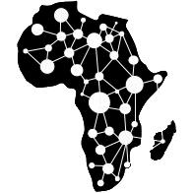

Environmental Data Acquisition and Processing
Water Resource Monitoring and Catchment Analysis
By
Jason Kabi
Centre for Data and Artificial Intelligence
DSAIL
1

Slide 2
Session breakdown
Session Brake Down
Motivation – The main goal
What water parameters are being monitored?
How are the parameters monitored?
Hardware development
Data acquisition
Data analysis – Anomaly detection
2

Slide 3
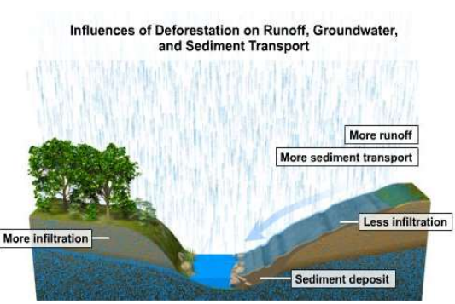
Motivation
Main goal: River catchment analysis using water-level data by leveraging IoT and machine learning
Takeaways
Water level data can be used to “diagnose” a river catchment by watching the trends over some time.
Question: How long does a spike in water level take to occur after a spike in rain.
3

Slide 4
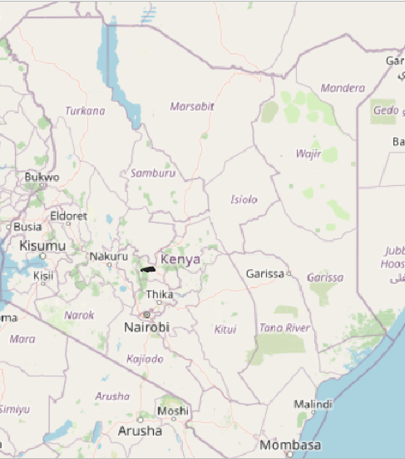
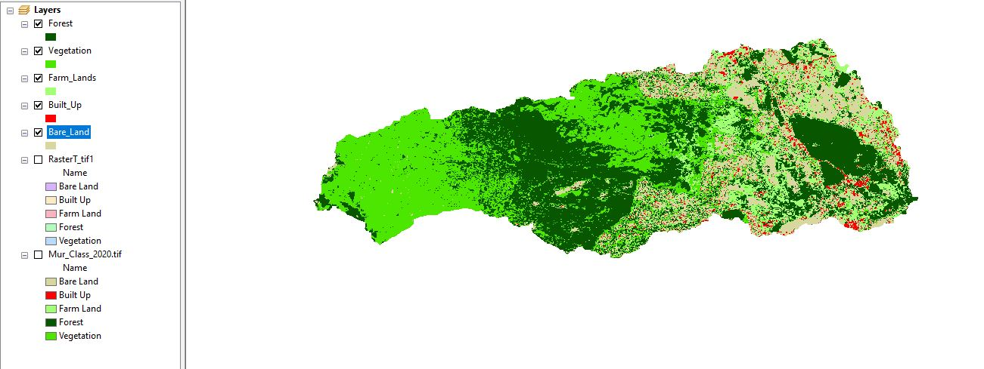
Catchment under study
Muringato Water shed – Nyeri county - Kenya
4

Slide 5
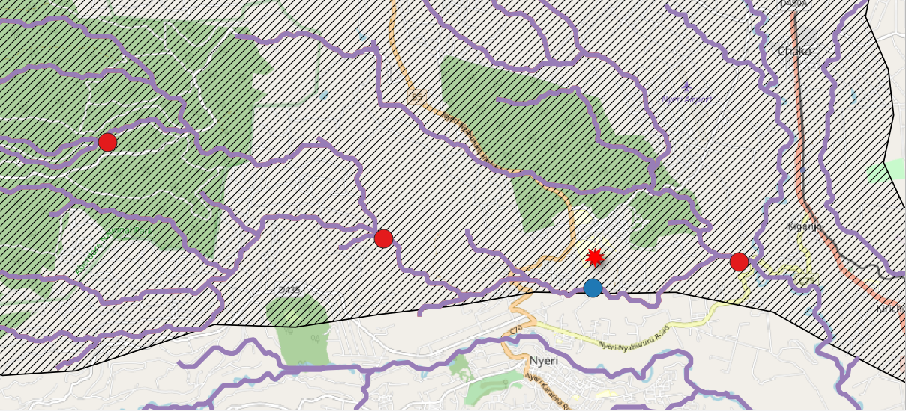
Deployment location (catchment under study)
5

Slide 6
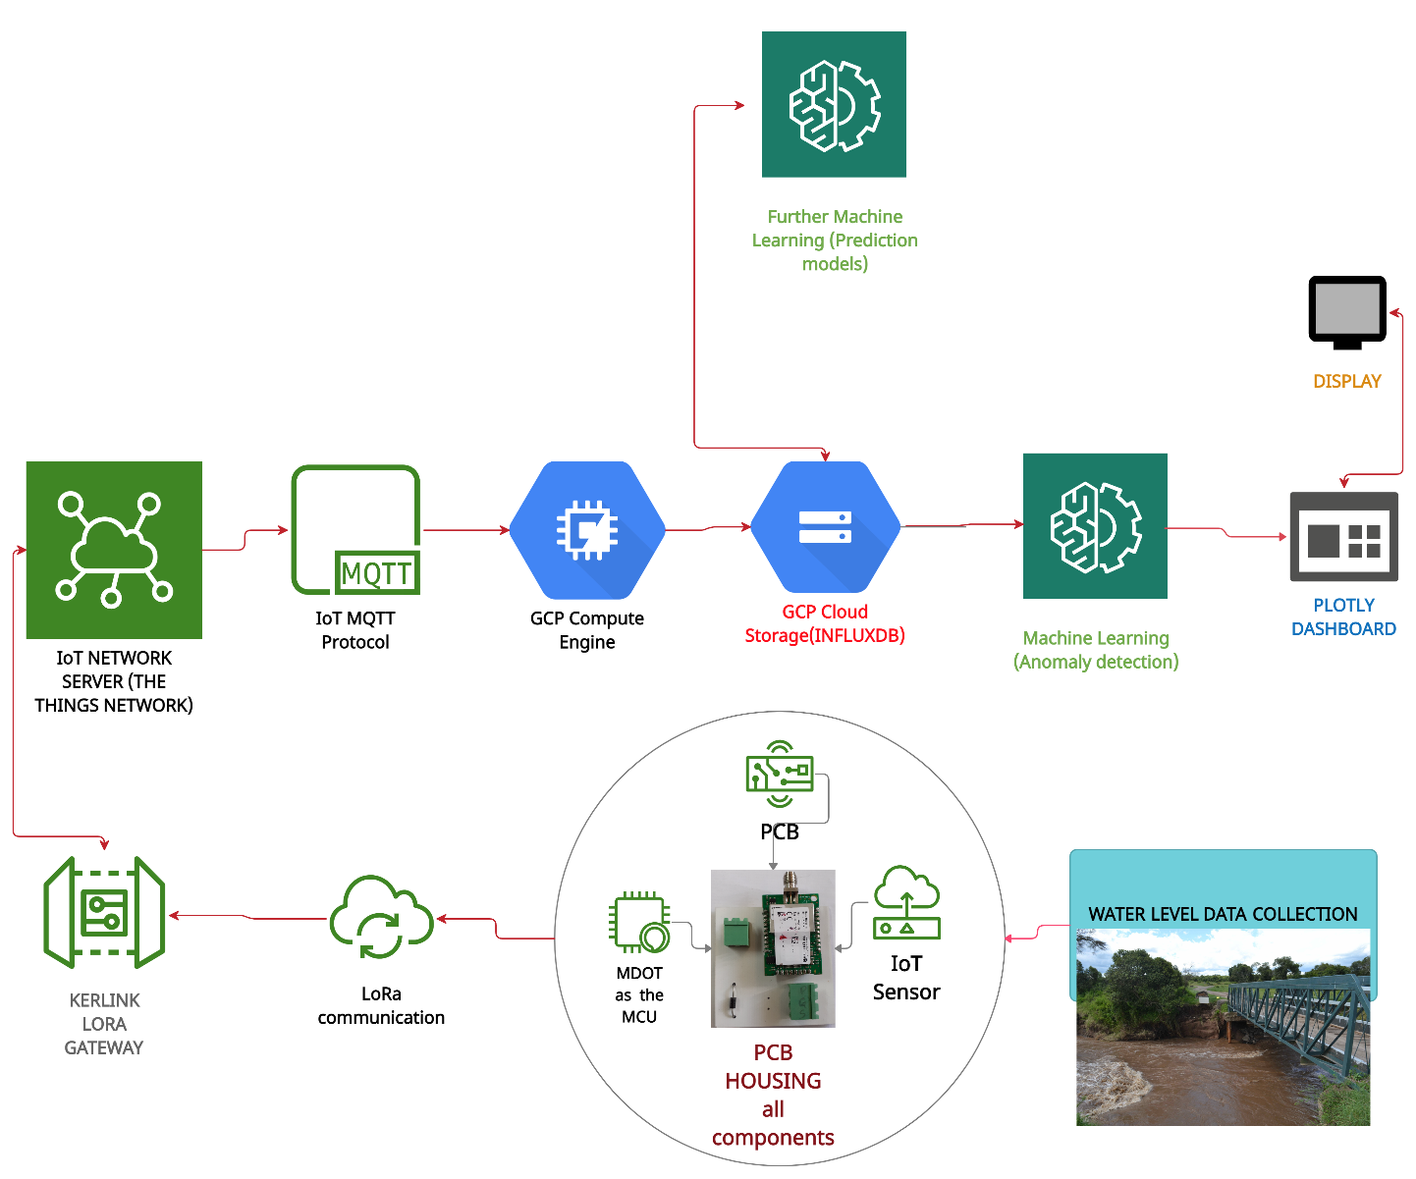
Water level monitoring setup (Flow Chart)
6

Slide 7
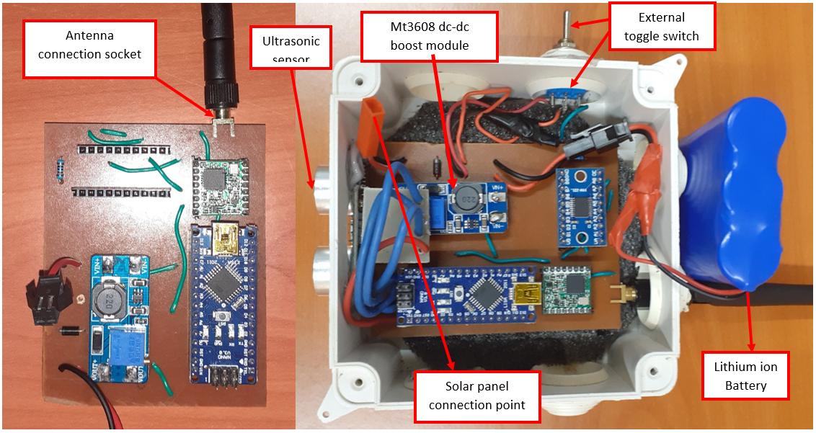
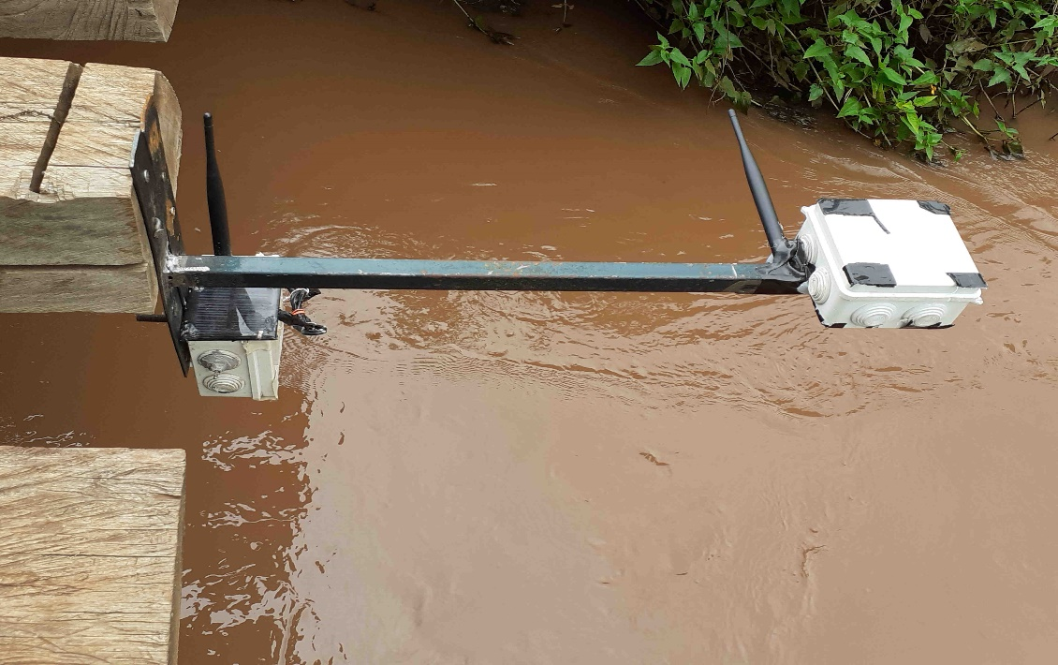
Hardware setup
Ready for deployment
Deployed
7

Slide 8
UPNEXT
ANOMALY DETECTION ON TIME SERIES WATER LEVEL DATA
8

Slide 9
THANK YOU
Web - Dekut-dsail.github.io
Web - kabi23.github.io
Github – DEKUT-DSAIL
9

